Slide 1
Software Design and Architecture

Slide 2
Unified Modeling Language
Unified Modeling Language (UML) is a standardized general-purpose modeling language in the field of software engineering.
The Unified Modeling Language (UML) is used to
  specify,
  visualize,
  modify,
  construct and
  document
the artifacts of an object-oriented software-intensive system under development.

Slide 3
UML Diagrams
UML models the system to be built by following diagrams:
  Use Case Diagrams
  Class Diagrams
  Interaction Diagrams - Sequence & Collaboration
  Activity & State Diagrams
  Implementation Diagrams - Component & Deployment

Slide 4
UML Diagrams
UML diagrams represent two different views of a system model :
Static (or structural) view:
  emphasizes the static structure of the system using objects, attributes, operations and relationships.
  The structural view includes class diagrams and composite structure diagrams.
Dynamic (or behavioral) view:
  emphasizes the dynamic behavior of the system by showing collaborations among objects and changes to the internal states of objects.
  This view includes sequence diagrams, activity diagrams and state machine diagrams.

Slide 5
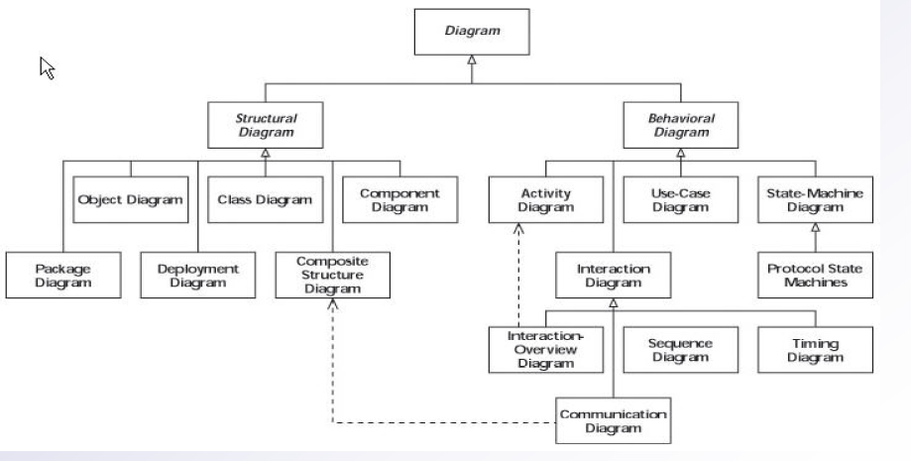
UML Diagrams

Slide 6
Flowchart
A flowchart is a type of diagram that represents an algorithm or process, showing the steps as boxes of various kinds, and their order by connecting these with arrows.
This diagrammatic representation can give a step-by-step solution to a given problem.
Flowcharts are used in analyzing, designing, documenting or managing a process or program in various fields.

Slide 7
Process operations are represented in these boxes,
Arrows connecting them represent flow of control.
Example:
  Algorithm for calculating factorial.
      Read input
      Initialize variables
      Multiply factorial
      Check terminating condition
      Print results

Slide 8
